Slide 1
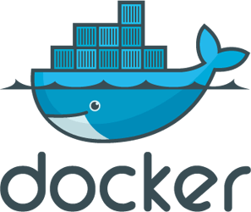
Docker 101
Paul McGrath
@blorgfester

Slide 2
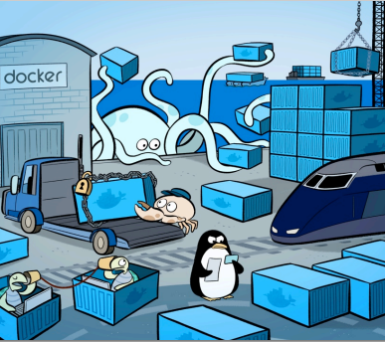
What will we learn today?
Outline of docker and what it can be used for
Build and run an python app
Build and run an app with a database
Use docker to compile .net code and run tests
Not install anything again, ever.

Slide 3

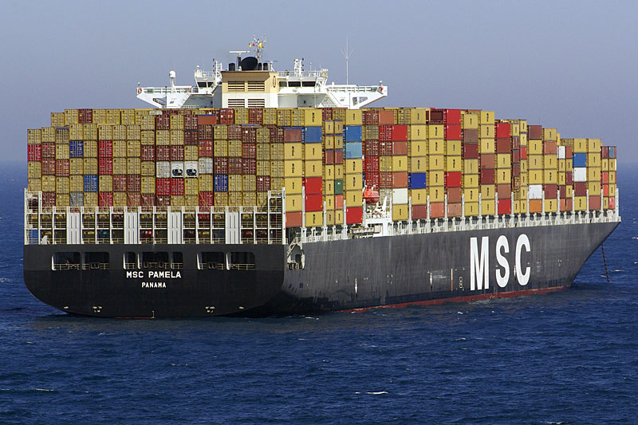
What is Docker?
Shipping container analogy
Build and run, any application, anywhere.
Linux tool
Isolated processes in containers are an old idea

Slide 4
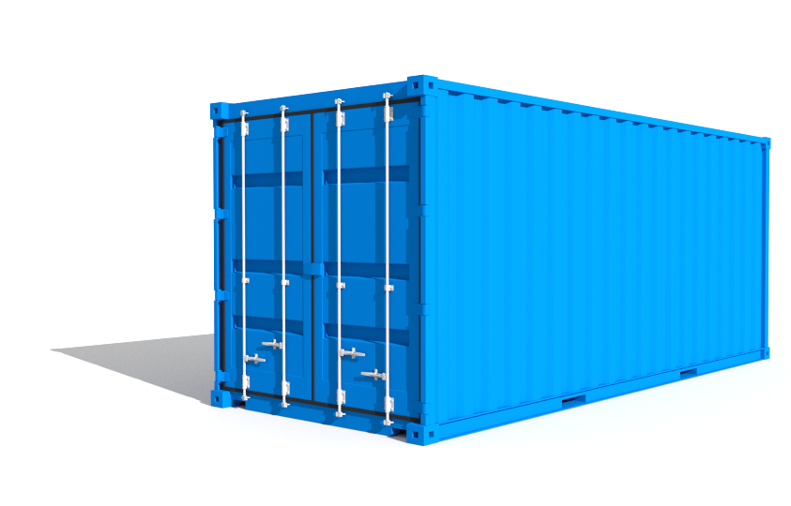
Images and containers
An image is essentially a template.
Created with the docker build command.
Can be built from other images in layers.
A container is a running instance of an image.
Started with the docker run command.

Slide 5
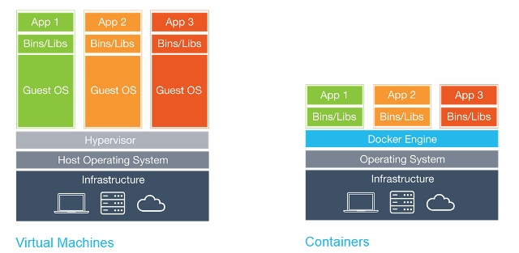
Why not just use a virtual machine?
Containers are isolated but share OS (linux kernel)
Faster startup
Less overhead
Easier migration

Slide 6
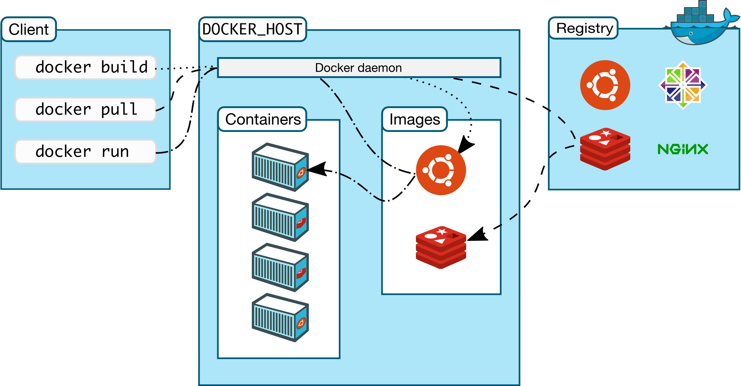
Docker architecture
Use docker version to see details of client/server versions
Notes:
docker version

Slide 7
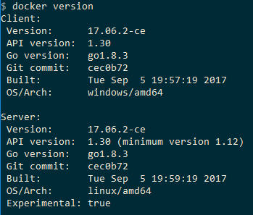

Type docker version at the command prompt
Notes:
docker run alpine echo "Ready to learn docker"

Slide 8

What was in that pre-workshop script?
Image name (alpine linux)
CMD to be run in container
Output from container
i.e. hello from linux docker_host
Notes:
docker run -p 5959:80 dockersamples/static-site

Slide 9
Let’s try another
docker run –p 5959:80 dockersamples/static-site
If you’re using docker toolbox:
Run docker machine ip default to get the DOCKER_HOST ip address
Then visit localhost:5959/ in your browser

Slide 10
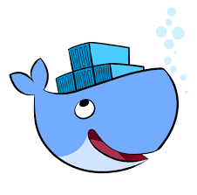
How was that created?
A “Dockerfile” describes an image
Image is built by running docker build .
FROM nginx
ADD html /usr/share/nginx/html
EXPOSE 80

Slide 11

The Dockerfile
FROM – The base image to use e.g. nginx
RUN – A linux command to run when building
EXPOSE – Specify ports that are used at run time
ADD – Copy files from your system into the container
CMD – Command to run that can be overridden as part of docker run
CMD ["executable","param1","param2"]
Notes:
cd first-container
Show dockerfile
docker build -t my-app

Slide 12
Stop!
Open another terminal window and run
docker ps
Copy the CONTAINER ID of the container you want to stop running
Then run:
docker stop <id-that-you-copied>

Slide 13
Build your own image…
Cd to the folder where you cloned the git repo github.com/pavlosmcg/docker101
In first-container directory
Create this “Dockerfile”
Run docker build . –t my-app
FROM python:3.4-alpine
ADD . /code
WORKDIR /code
RUN pip install -r requirements.txt
EXPOSE 5000
CMD ["python", "app.py"]
Notes:
docker run -p 5858:5000 my-app

Slide 14
…and run your own container
docker run –d –p 5858:5000 my-app
Then visit localhost:5858/ in your browser
Notes:
BREAK

Slide 15

General investigation tips
docker ps -- shows running containers
docker ps –a -- also shows stopped containers
docker images -- shows all available images
docker logs <container id> -- shows stdout from container
docker exec <container id> <command> -- run a new command on a running container
E.g: docker exec -it <container id> /bin/sh
Notes:
docker ps –a
docker logs <id>
docker exec -it e72928639a2a /bin/sh
docker run -it alpine /bin/sh

Slide 16
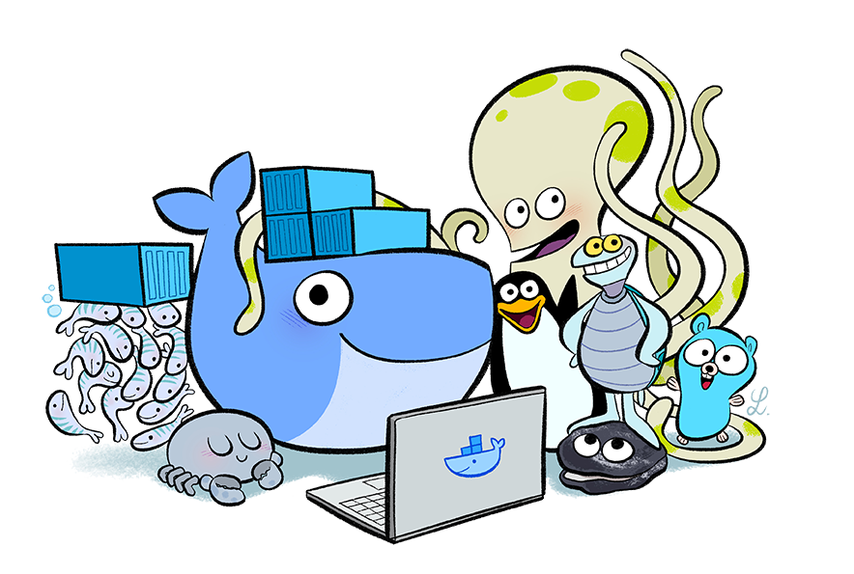
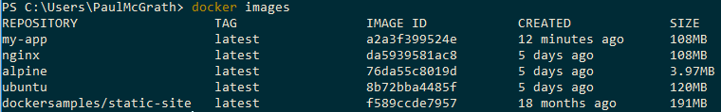
Take a look at your docker host
docker images
docker ps
docker ps -a

Slide 17
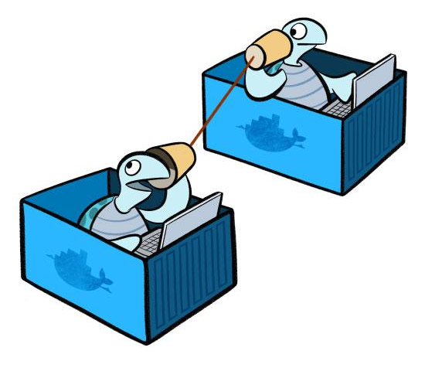


Communicating between containers
A project is usually more than a web layer
You may want to scale UI or backend independently
Introducing docker-compose

Slide 18
Create a docker-compose file…
Create docker-compose/docker-compose.yml:
version: '3'
services:
web:
build: .
ports:
- "4545:5000"
redis:
image: "redis:alpine"
Notes:
docker-compose build
docker-compose up –d
localhost:4545/

Slide 19
…and run your two communicating containers
docker-compose build
docker-compose up -d
Then visit localhost:4545/ in your browser

Slide 20
Compiling Windows .NET Framework code…
Yes, this really is .NET <5 code building and running in a linux container
docker run --rm --volume "$pwd}:/build" --workdir /build mono ./build.sh
Running unit tests
docker run --rm --volume "${pwd}:/build" --workdir /build mono ./tests.sh
Notes:
cd build-and-test
show the code
docker run --rm --volume "$(pwd):/build" --workdir /build mono ./build.sh
docker run --rm --volume "$(pwd):/build" --workdir /build mono ./tests.sh

Slide 21
Try building my C# project without .net installed
In the build-and-test directory
docker run --rm --volume "$(pwd):/build" --workdir /build mono ./build.sh
docker run --rm --volume "$(pwd):/build" --workdir /build mono ./tests.sh

Slide 22
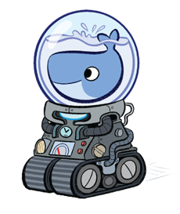
Cleaning up
Stop containers: docker stop <id or name>
docker-compose stop
Remove stopped containers: docker rm <id or name>
Remove images: docker rmi <id or name>
Stop all containers: docker stop $(docker ps -a -q)
Remove all containers: docker rm $(docker ps -a -q)
Remove unused data: docker system prune -a
Notes:
Stop all containers: docker stop $(docker ps –aq)
Remove all containers: docker rm $(docker ps –aq)
Remove dangling images: docker rmi $(docker images -f dangling=true -q)
Remove dangling images: docker volume rm $(docker volume ls -f dangling=true -q)
docker system prune
To additionally remove any stopped containers and all unused images (not just dangling images), add the -a flag to the command:
docker system prune –a
cd team-city
show dockerfile
show docker-compose
docker-compose up -d
docker-compose scale agent=3

Slide 23
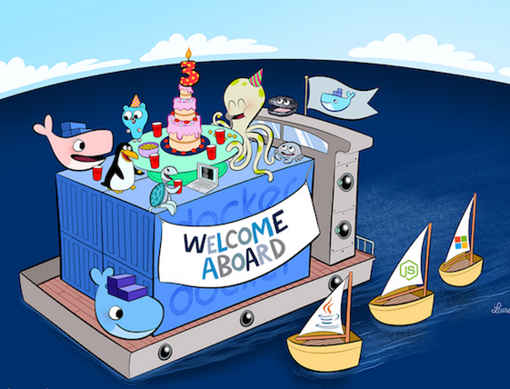

THANK YOU
@blorgfester

